Slide 1
Data Science Capstone Project
Local Governments Survey (ARISE + CivicPulse Harmonization)
Course Number:CS896 Team #7- Anudeepthi Chirumamilla- Y828R524 Rupali Avhad - d798z925 Teja Sree Mukkapati-Q389W584

Slide 2
Project Progress Update
Last week:
Reviewed and understood the codebook and ARISE dataset.
Examined to obtain similar constructs in the CivicPulse codebook.
This week (Deliverables)
Verified the variables and structure of the CivicPulse response dataset.
Completed the crosswalk table, which aligns important constructs between the two datasets.

Slide 3
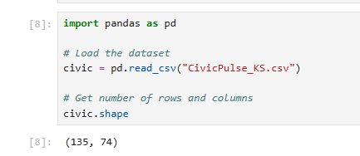
CivicPulse Dataset
The dataset has 135 rows, 74 columns
Each row represents one local government official who answered the survey.
Each column represents one survey question or data field.
Variables fall into three main categories:

Slide 4
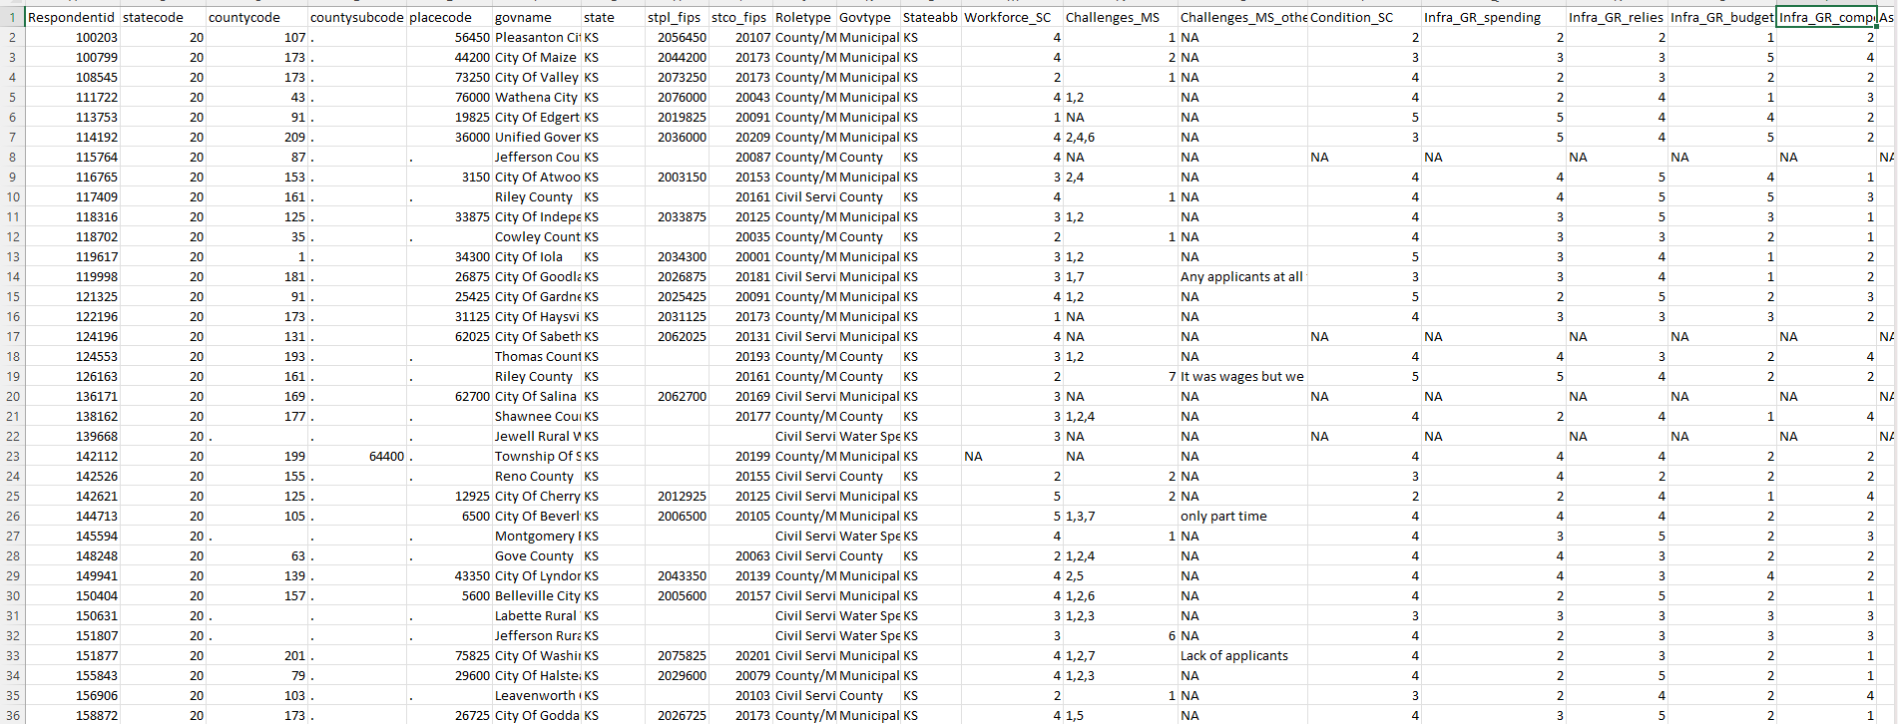
CivicPulse Dataset

Slide 5
Categories of dataset
Rating scale variables(1–5)
These measure intensity or agreement.
Examples:
Workforce_SC → Workforce challenge level
Condition_SC → Fiscal condition rating
Infra_GR_spending → Infrastructure spending adequacy
Infra_GR_budget → Infrastructure budget sufficiency
Scale meaning:
1 = Very low / Strongly disagree
5 = Very high / Strongly agree
These are directly usable for analysis.

Slide 6
Categories of dataset
2.Multi-Select Coded Variables
Example:
Challenges_MS Values may look like:
4,1,2 3,2,4
This means:
The respondent selected multiple answer choices.
Each number corresponds to a coded option from the codebook.
3. Metadata Variables
Examples:
Respondentid
statecode
countycode
govname
Govtype

Slide 7
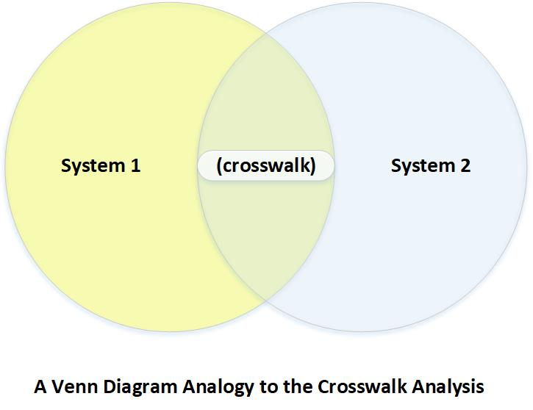
Purpose of the Crosswalk Table
The crosswalk is the core document used to align variables between the ARISE and CivicPulse surveys.
Its purpose is to identify:
Which variables measure the same concept,
How closely they match,
How they should be recoded,
and how they will be represented in a harmonized dataset.
Because ARISE and CivicPulse use different variable names, question wording, response scales, and missing-value conventions, the crosswalk acts as a translation map between the two survey systems.

Slide 8
Why the Crosswalk Was Necessary
ARISE and CivicPulse cover similar themes, such as:
workforce capacity
fiscal condition
infrastructure finance
disaster services
preparedness
respondent demographics
However, they differ in:
Variable naming style
Question wording
Response formats
Coding structure
Missing value labels
Because of this, raw variables cannot be directly compared.
The crosswalk was necessary to create a common framework for later coding and analysis.
Example
ARISE → Q... style variables
CivicPulse → _SC, _GR, _MS style variables

Slide 9
Inputs Used for Crosswalk Creation
To create and validate the crosswalk, we used:
ARISE side
CivicPulse side
ARISE side
ARISE questionnaire
ARISE codebook
ARISE dataset
CivicPulse side
CivicPulse questionnaire
CivicPulse codebook
CivicPulse dataset
How they helped:
Questionnaire what was asked
Codebook how variables were defined
Dataset how responses were actually stored

Slide 10
Crosswalk Creation Process
To build the crosswalk correctly, the following process was used Step 1: Review ARISE codebook The ARISE codebook was read to identify:
Candidate variables for harmonization,
Response coding systems and variable naming conventions.
This helped establish the ARISE side of the crosswalk.
Step 2: Review CivicPulse questionnaire The CivicPulse questionnaire was reviewed to understand:
What each survey block measures,
The wording of the questions,
and the response structure (single-choice, grid, select-all, etc.).
This helped identify concept-level matches to ARISE variables.
Step 3: Review CivicPulse codebook The CivicPulse codebook was used to confirm:
Exact variable names from the questionnaire concepts,
Field-level labels and descriptions,
and coding structures needed for the crosswalk.
This helped establish the CivicPulse side of the crosswalk.
Step 4: Verify variables in ARISE dataset The ARISE dataset CSV was checked to ensure:
The variables listed in the ARISE codebook are present,
Coding appears as expected,
and the columns are usable for harmonization later.

Slide 11
Crosswalk Creation Process
Step 5: Create crosswalk rows For each comparable concept, a row was added to the crosswalk with:
Harmonized variable name,
ARISE and CivicPulse variable details,
Match type,
Harmonization rule,
Output scale,and missing value rule.
Step 6: Document uncertainty and partial matches Not all variables match exactly. For these cases, the crosswalk includes:
Match_Type labels (Exact / Partial / Derived / No match),
Notes on wording differences,
and recoding plans for later implementation.
This is important for maintaining transparency and avoiding incorrect assumptions.

Slide 12
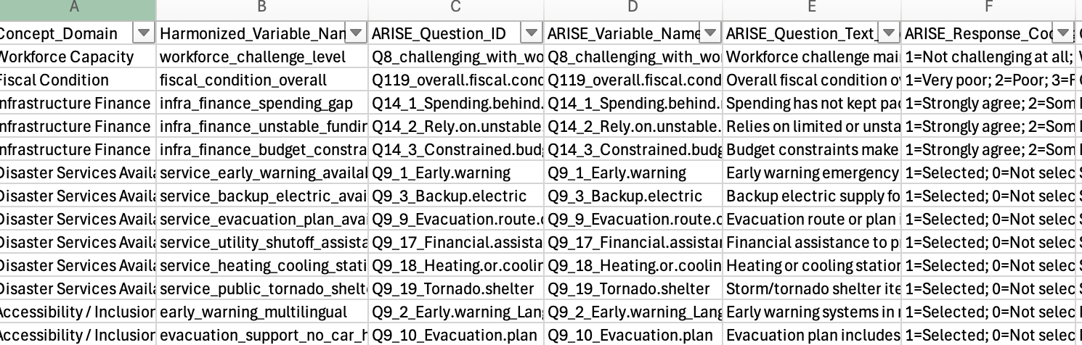
Crosswalk Table Structure
Each crosswalk row contains
Concept_Domain
Harmonized_Variable_Name
ARISE_Question_ID
ARISE_Variable_Name
ARISE_Question_Text_Short
ARISE_Response_Coding
CivicPulse_Question_Block
CivicPulse_Variable_Name
CivicPulse_Question_Text_Short
CivicPulse_Response_Coding
Match_Type
Harmonization_Rule
Output_Scale
Missing_Value_Rule
Notes

Slide 13
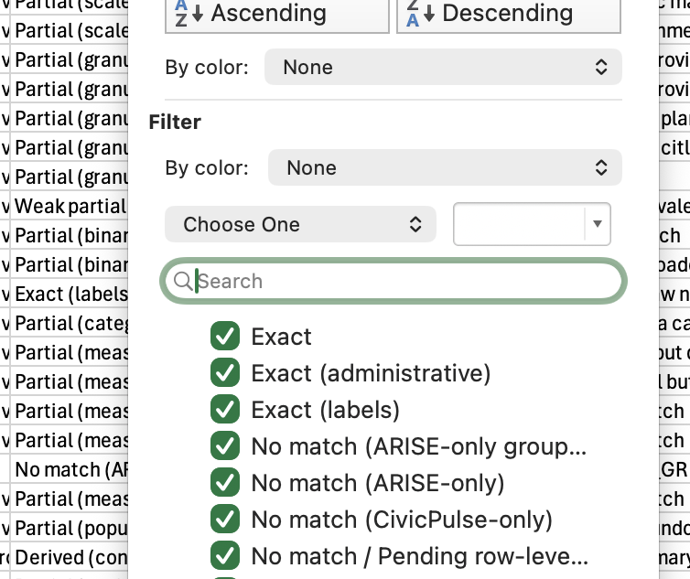
Match Types in the Crosswalk
We classified each row using a match type:
Exact → same concept and same/very similar scale
Partial → same concept but wording or coding differs
Weak partial → related idea, but not directly equivalent
Derived → requires recoding or aggregation
No match → variable exists only in one source
Why this matters:
This prevents us from forcing weak matches into exact comparisons and keeps the crosswalk methodologically honest.

Slide 14
Crosswalk Example: Exact Match
Example 1: Fiscal Condition (Strong Match) Both surveys include a question about the local government’s overall fiscal condition over a recent time period. This is a strong harmonization candidate because
the concept is the same,
the response scale is ordinal,
and the wording is very similar.
Crosswalk result:
Match_Type: Exact (or near exact)
Output_Scale: Ordinal (1–5)
Harmonization_Rule: Direct harmonized mapping to common 1–5 scale

Slide 15
Crosswalk Example: Partial Match
Example 2: Service Availability (service_early_warning_available)
ARISE: stores whether the service is present as a binary selected/not selected variable
CivicPulse: stores the same concept through provider information in Services_GR_early
This means the concept is similar, but the raw format is different
Why this is a partial match
ARISE answers: Does the service exist?
CivicPulse answers: Who provides the service?
CivicPulse has more detail than ARISE
Crosswalk decision
Match_Type: Partial
Output_Scale: Binary (0/1)
Harmonization_Rule: any provider code = available, Not provided = not available

Slide 16
Challenges Identified During Data Understanding
Different naming conventions (Q... in ARISE vs _SC/_GR/_MS in CivicPulse)
Different response formats (single-choice vs grid vs multi-select)
Different missing value labels (NA, blanks, “Don’t know”, “Not applicable”)
Some variables are only partial matches and require documented assumptions

Slide 17
Crosswalk Improvements After Dataset Validation
Once we received the real CivicPulse dataset, we rechecked the CivicPulse side of the crosswalk and corrected:
actual field names
actual stored response codes
missing-value format
provider-grid structure for service variables
follow-up variable coding
metadata field names
Important finding:
The actual dataset helped us verify that some variables were stored differently than the questionnaire alone suggested.

Slide 18
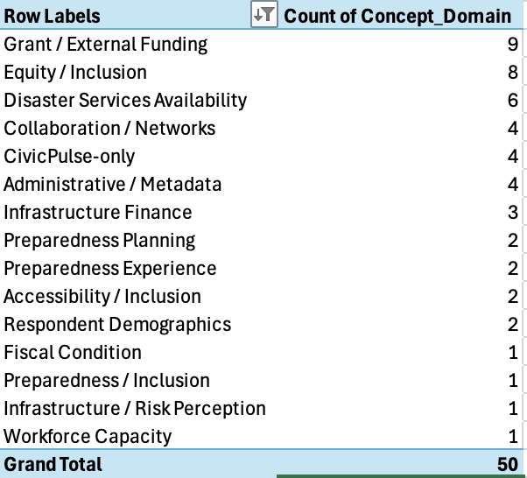
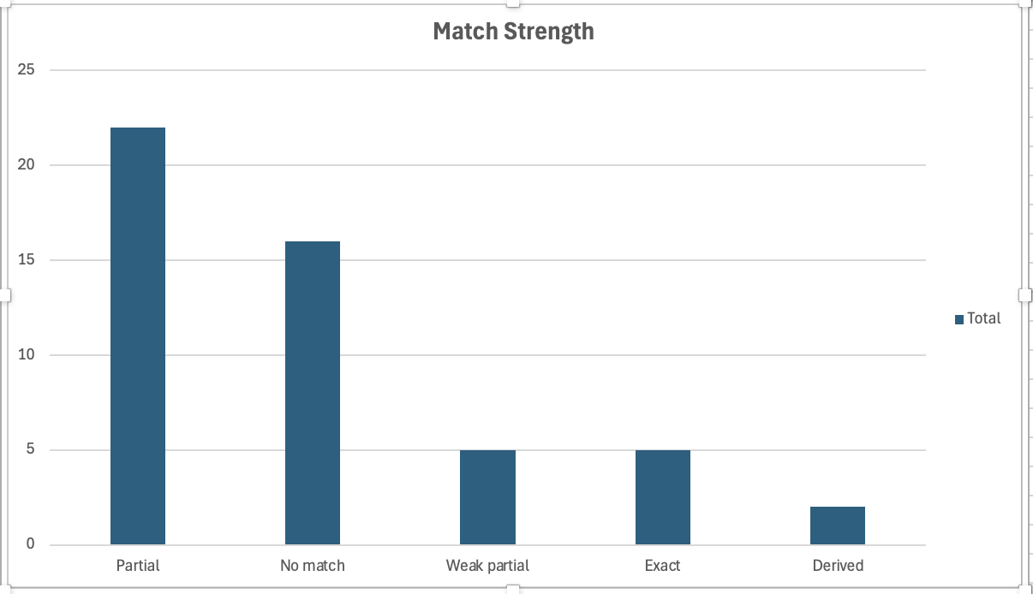
Crosswalk Status Summary

Slide 19
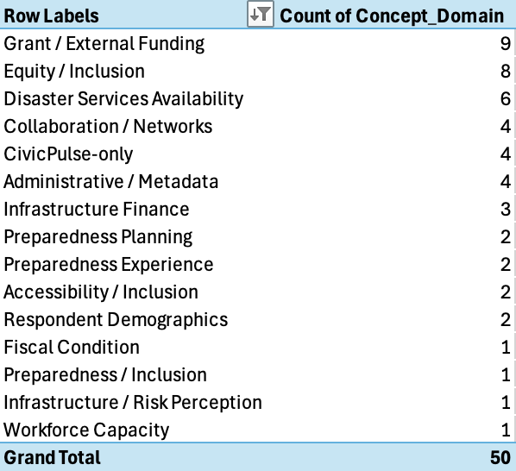
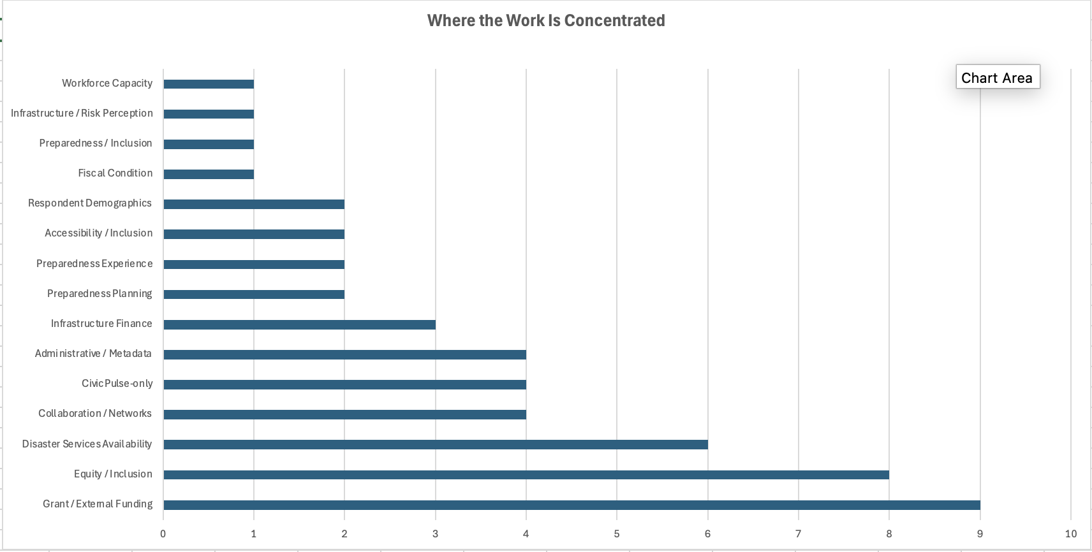
Crosswalk Status Summary

Slide 20
Crosswalk Status Summary
Most crosswalk rows are partial matches, which is expected because ARISE and CivicPulse often measure similar concepts using different scales and structures. The largest share of harmonization work was concentrated in grant funding, equity/inclusion, and disaster services, where variable mapping required more detailed review.

Slide 21
Next Week Goal
Our next week goal is to move from crosswalk design to actual implementation. We plan to finalize coding notes and the harmonized data dictionary, start recoding variables in Python or Excel, create the first harmonized dataset, and then run quality checks before moving into descriptive analysis.

